Slide 1
research binders

Slide 2
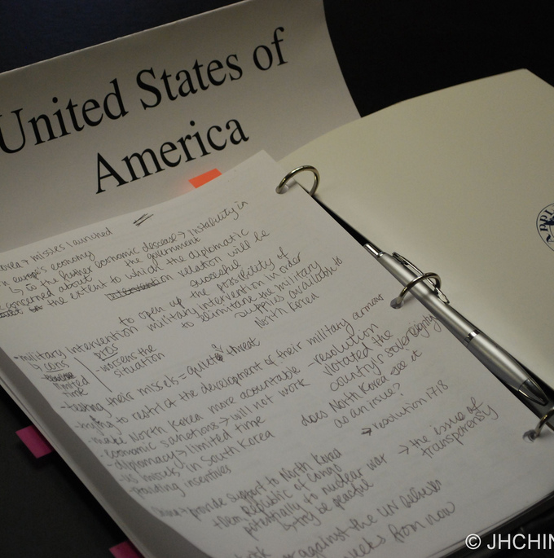
Research Binder
Binder that compiles all notes, references, and resources gathered during research
Includes information on the conference, committee, country, topics, policies, and solutions

Slide 3
Conference and Committee
Includes conference rules, and schedule
Committee- Overlook of your committees website
Will give you information on:
Mandate-why it was created
Powers-what it can do
Organization-how it fits into the UN and the larger international community
Membership-who’s in it
UN Charter- Foundational treaty of the UN, will further list the powers of one’s committee

Slide 4
Country
Overlook of CIA World Factbook and Wikipedia
Take notes on:
Country’s location
Neighbors
Population size
Type of government
Type of economy
Trade partners
International organizations it’s a part of

Slide 5
Topics
Include: printed background guide
News Articles and/or notes on news articles
Past Resolutions on the topic
Resolutions can be found in the UN Documentation Center
This will allow you realize what the UN has already done to tackle the issue, as bringing up past failed solutions can be rather embarrassing

Slide 6
Country Policies
Sheds insight on your country’s viewpoint on the presented issues
Can be extracted through speeches/press releases from the executive branch (i.e. President, Prime Minister, Ambassadors)
Voting Records on the issue can also drop hints on your country’s viewpoints
Your country’s Ministry of Foreign Affairs/Department of State website is a good place to start

Slide 7
Solutions
Commentary news articles, from the New York Times, Wall Street Journal, or any other large publication
Bodies of experts who come up with solutions
Ex. RAND.org
And of course, your ideas and conclusions based on evidence gathered

