Slide 1
Resolutions

Slide 2
What is a Resolution?
“A resolution is a document that contains all the issues that the committee wants to solve and the proposed solutions to that issue.”
Drafted during unmoderated caucus
During voting bloc, resolutions will be reviewed, voted on, and potentially passed if it receives a majority vote
Committees generally will allow multiple to pass
Written by sponsors, and supported by signatories
Signatories may/may not support it, but wish to see it discussed further on the floor
Composed of 3 sections, the heading, the pre-ambulatory clauses, and the operative clauses
Make sure you become very familiar with writing resolutions: a good solution cannot be put into play without a good resolution!

Slide 3
Heading
Contains the Committee name, sponsors, signatories, and the topic
Conferences generally require a minimum amount of signatories to be achieved in order for a resolution to be presented
This requires consensus building

Slide 4
Pre-ambulatory Clauses
States all the issues the committee wants to solve
Reminds committees why committees are trying to solve this issue, and emphasizes past international action
Can include:
Past UN/regional committee action
References to other documents
Statements by officials (UN Secretary General, Presidents)
General background statements about the issue (i.e. statistics)
Clauses end with commas

Slide 5
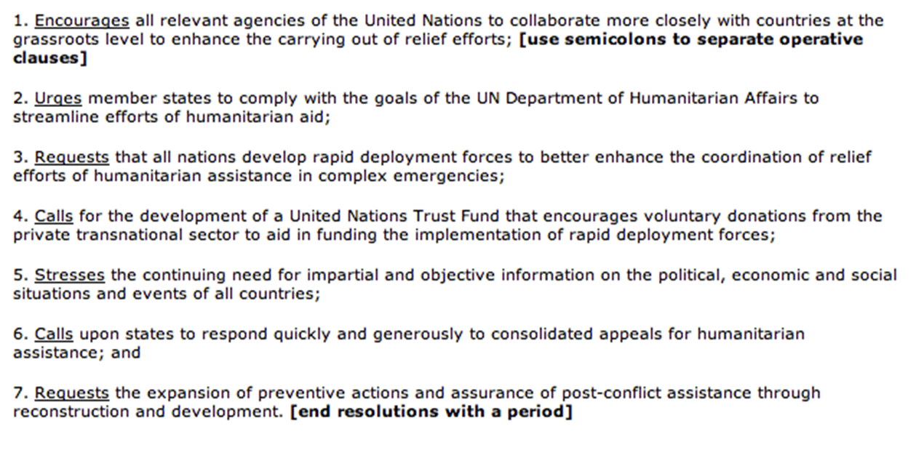
Operative Clauses
State the solutions to the issue
Clauses are numbered
Strategies: Include more detail, and answer the who, what, when, where, why, and how to the issue
Each clause ends with a semi-colon

